Slide 1
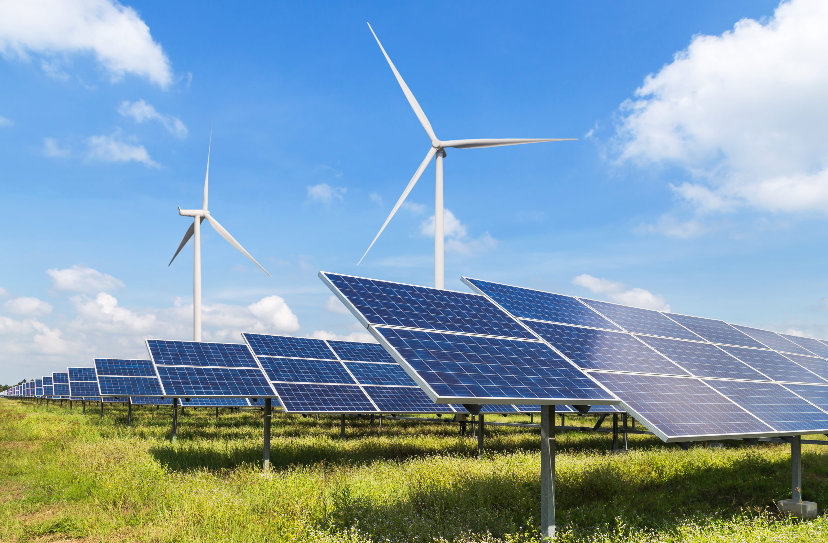
Solar Power Generation

Slide 2
Team Members
Chandrika Chokka
Snehal Jain
Y T Suryanarayana
Bejugam Aravind
Varun BR
Boddu Venkata Malini

Slide 3
Business Objective:
The primary goal is to model energy production as a function of environmental variables.
To provide accurate predictions that can help in optimizing solar energy supply.

Slide 4
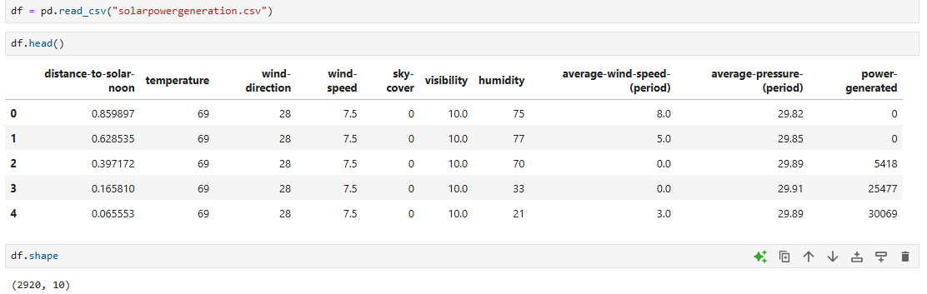
Loading the Dataset
There are 2920 rows and 10 columns in the dataset.
The target variable is Power Generated.

Slide 5
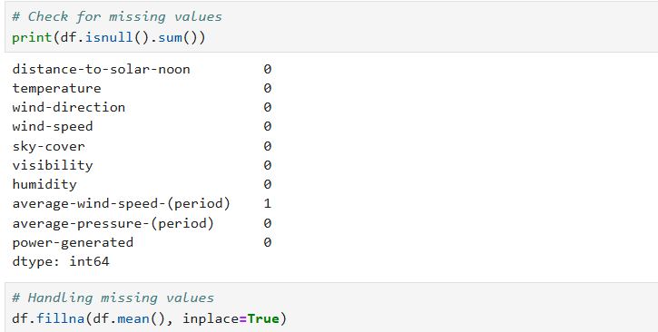
Exploratory Data Analysis
Data Cleaning
By checking the null values, we can see there is one null value in average-wind-speed-(period) column.
Handled that null value by replacing it with mean value.

Slide 6
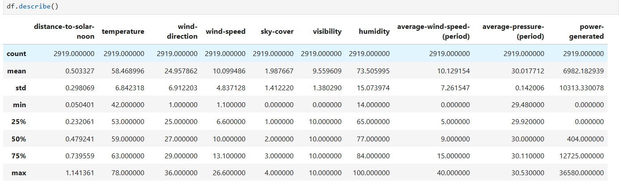
Descriptive Statistics
Here we can see the difference of mean value and 50th percentile of power generated column is very large ,there must be outliers in that column.
Checking for duplicate values

Slide 7
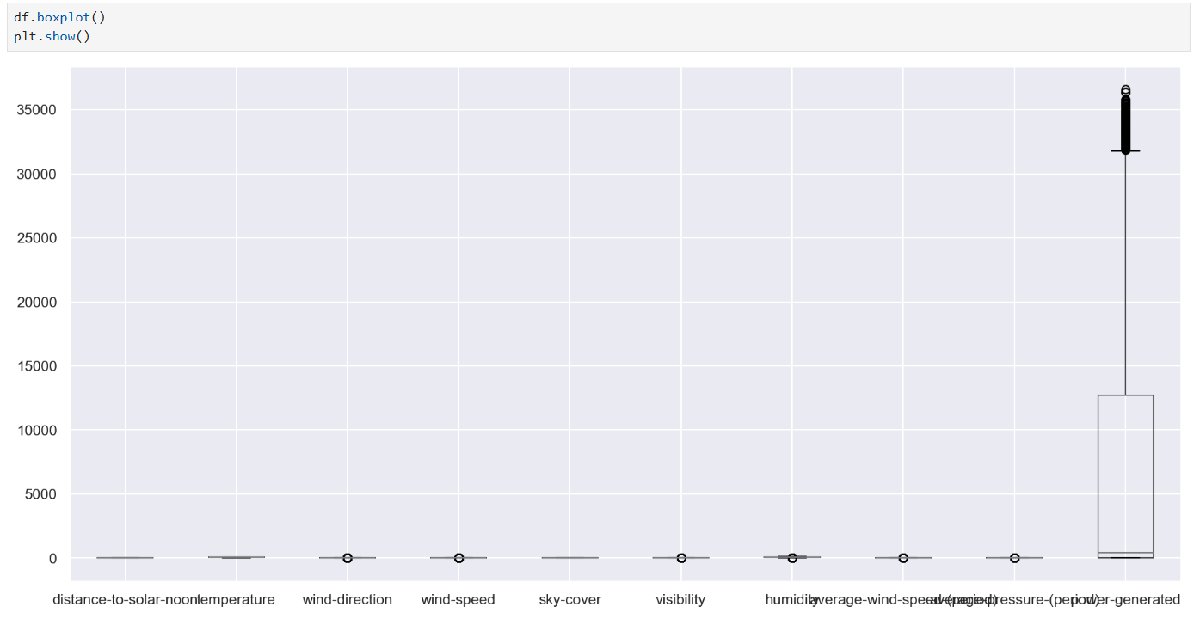
Visualization
Box Plot to check Outliers
As we observed earlier in the descriptive statistics, we can see there are outliers in the power generated column.

Slide 8
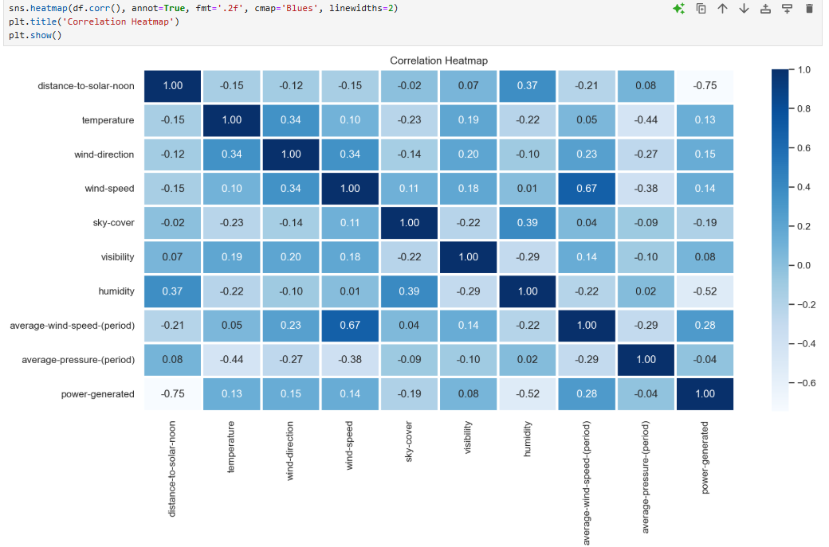
Correlation Heatmap

Slide 9
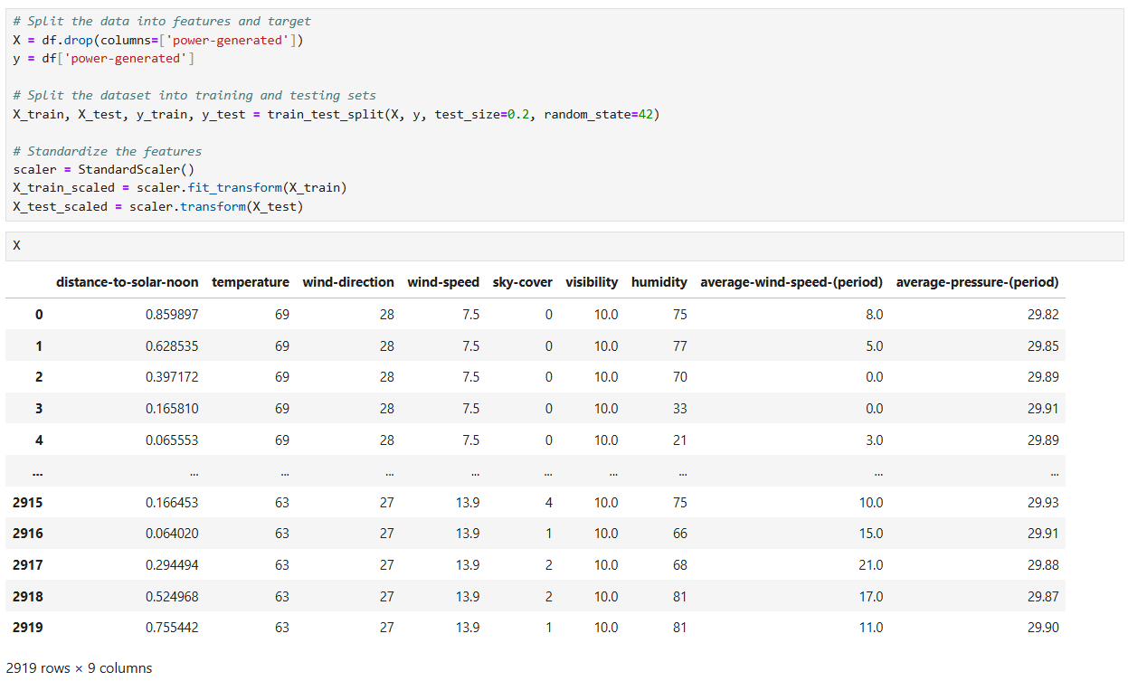
Model Building
Splitting the data into X and Y Variables . Power generated column as a target variable Y .
Here we have split the data into training and testing sets.

Slide 10
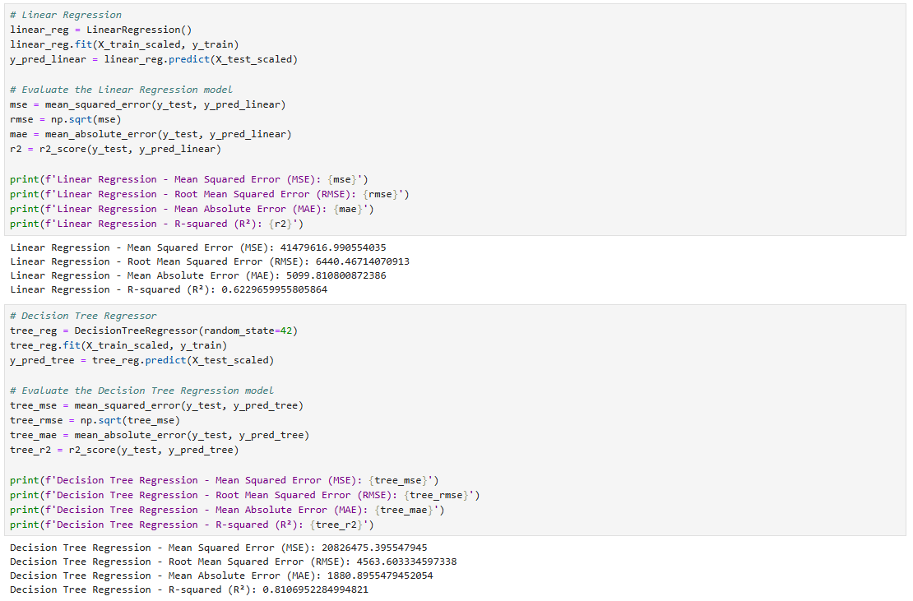
We have applied various algorithms such as Linear Regression, Decision Tree Regressor, Random Forest and Gradient Boosting Regressor on the data.

Slide 11
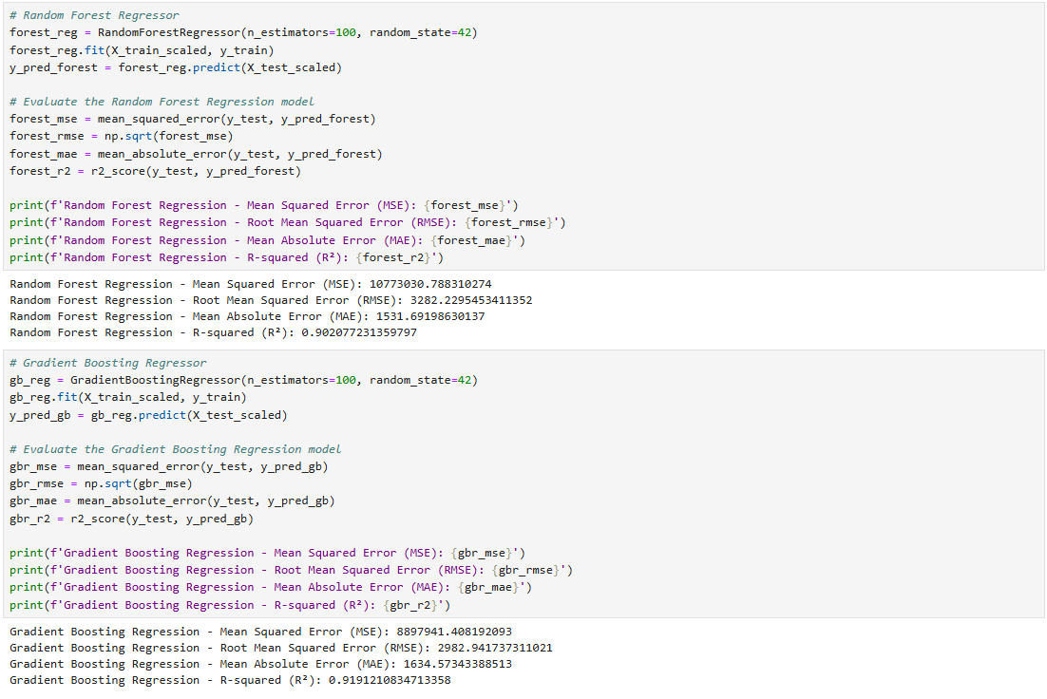
We are getting good accuracy for Gradient Boosting Regressor, so we are considering it.

Slide 12
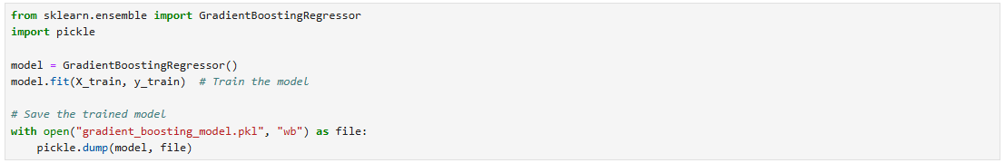
Deployment
Creating Pickle files
Trained the model using Gradient Boosting Regressor and created pickle files.

Slide 13
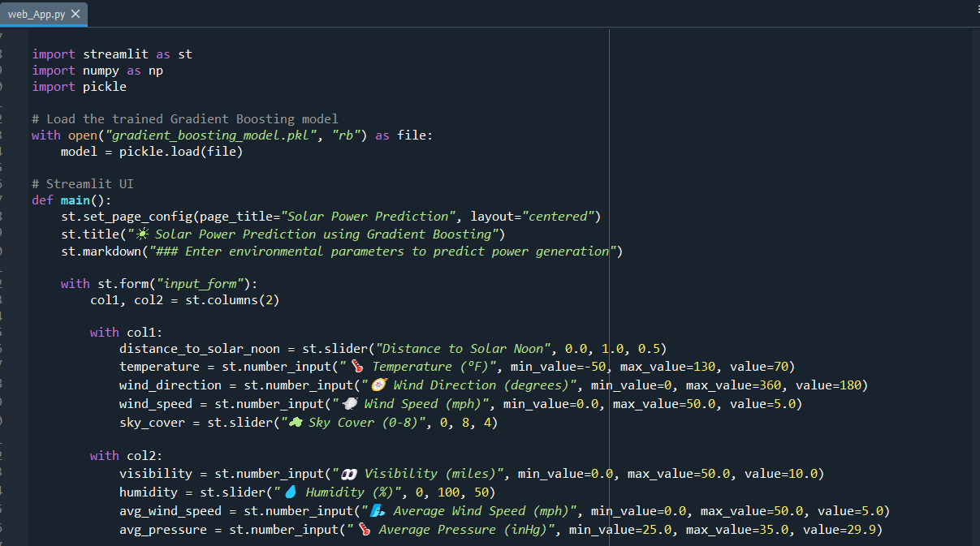
Creating Streamlit Application
Created Streamlit application as web_App.py.

Slide 14
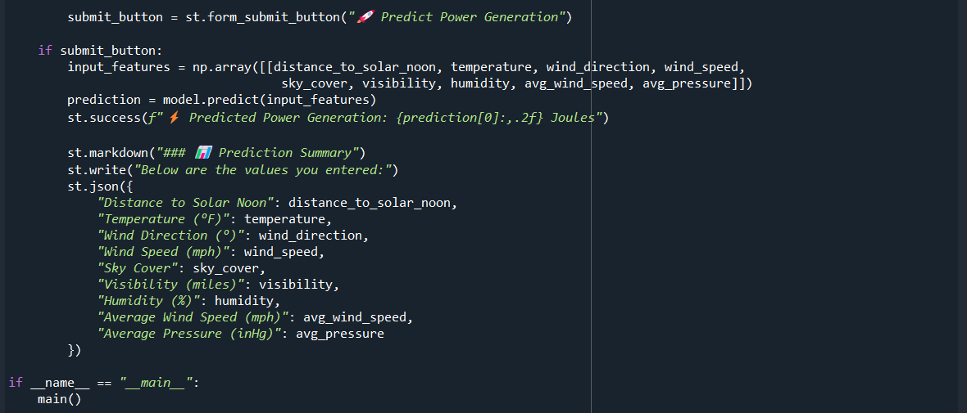

Slide 15
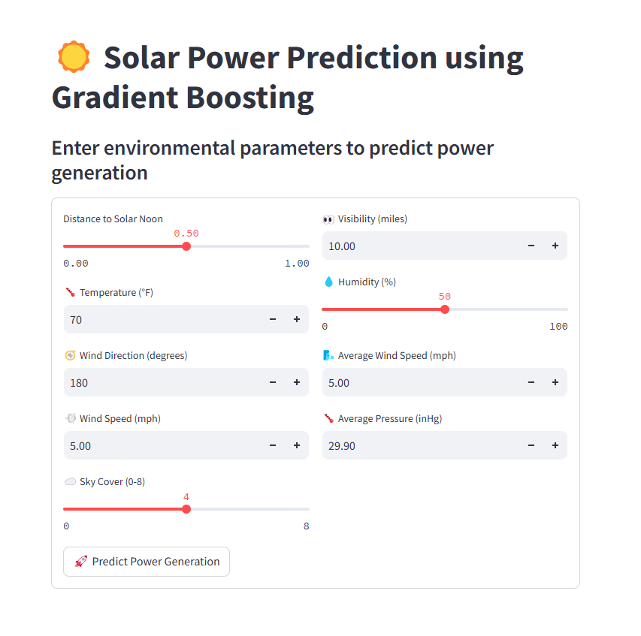
By writing streamlit run web_App.py in command prompt, it will direct to streamlit web page.

Slide 16
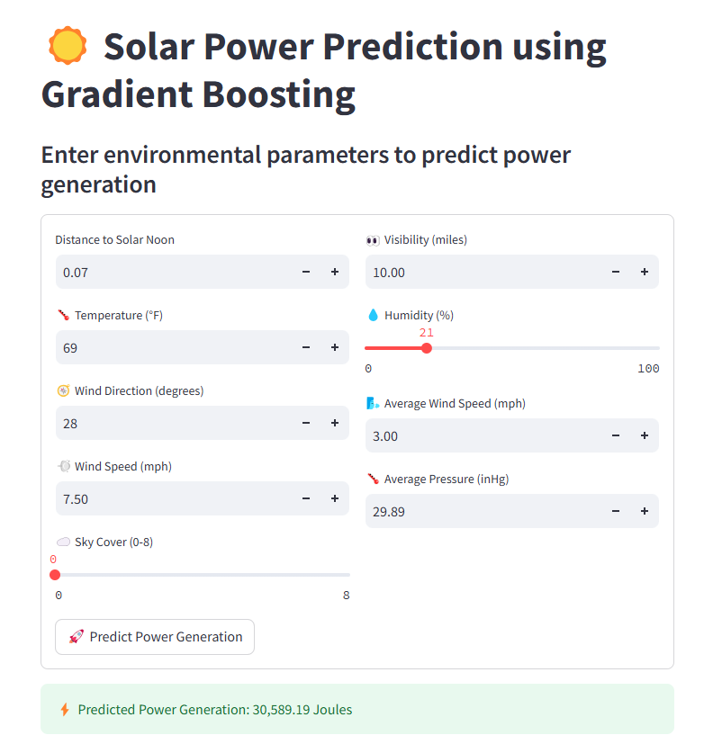
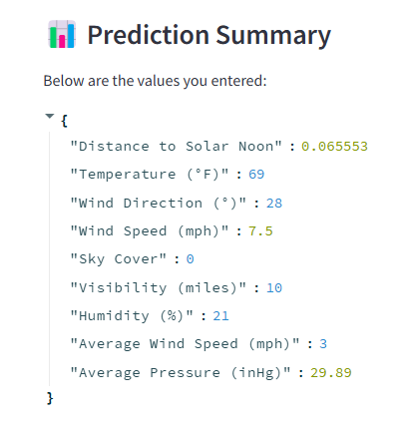
By entering the parameters, it will predict power generation.
We can also observe which parameters we have applied.
We got the accurate results by using Gradient Boosting Regressor.

Slide 17
Thank YOU

